Slide 1

Course Code | : | 19CSPN6401
Course Title | : | MINI PROJECT
Team Number | : | 14
Domain | : | IOT
Title | : | SMART ALERT SYSTEM FOR DROWSY DRIVER DETECTION
Guide | : | Mr. T. Kanagasabapathy, AP/CSE
Team Members | : | 20BCS067 | - | S.RAVIPRASATH
 |  | 20BCS069 | - | R.AJATHAN
 |  | 20BCS071 | - | S.SUBHAANANDH

Slide 2
Contents
Problem Statement
Survey on Existing System ( Minimum 5 systems/application)
Objective
Block Diagram of Proposed System
Software and Hardware Requirements
References (minimum 7)
Weekly Plan
Online Certification Courses

Slide 3
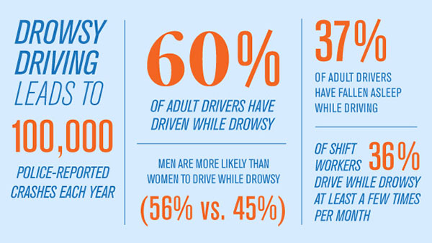
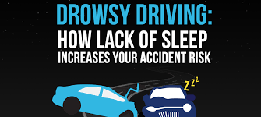
WHY?

Slide 4
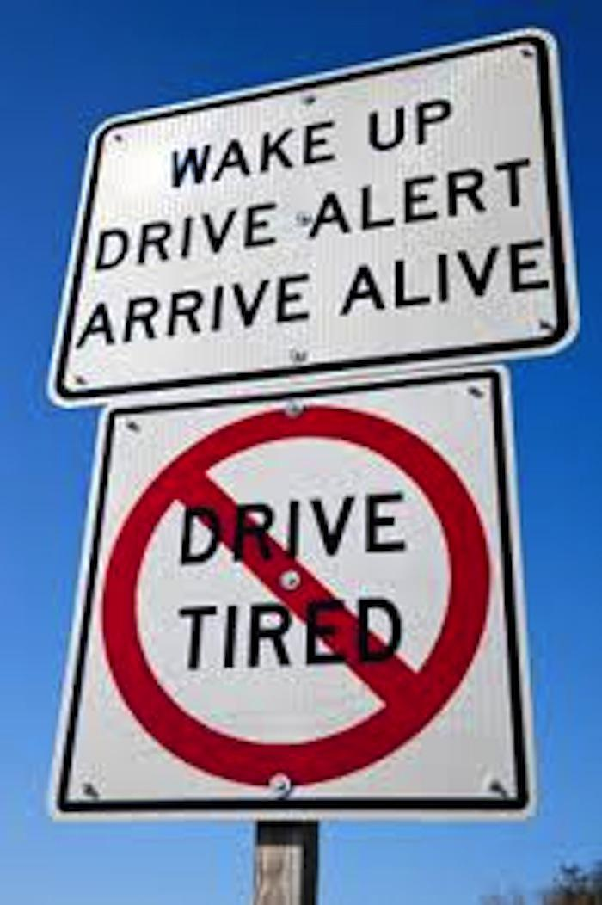
Problem Statement
The primary cause of accidents is due to the drowsiness of drivers in the nighttime. Fatigue and drowsiness are some of the leading causes of major accidents on Highways. The only solution to this problem is detecting the drowsiness and alerting the driver using buzzer.

Slide 5
Objective
Drowsiness in driving causes the major road accidents. Now a day’s drowsiness due to drunken driving is increasing. If driver is found to be drowsiness in eyes more than 5 secs, then the eye blink sensor
senses the blink rate. If the eyes are found to be closed, then the alarm sounds. Buzzer rings in case of drowsiness detection and speed of
the car varies on detection of both cases.

Slide 6
Survey on Existing System
Title | Source(Website) | Year | Inference
Vehicle position in lane monitoring | https://www.ijltemas.in/most-viewed-papers/a-survey-on-driver-drowsiness-detection-techniques.com | 2017 | Drowsiness can be detected by changing the lane
Mouth and Yawning Analysis | https://ieeexplore.ieee.org/document/8704263 | 2015 | Drowsiness can be detected when yawning
Head positioning and movement | https://citeseerx.ist.psu.edu.com | 2016 | Drowsiness can be detected by the movement of head and head poitioning
Automatic Detection of Driver Fatigue | https://ieeexplore.ieee.org | 2016 | Image processing

Slide 7
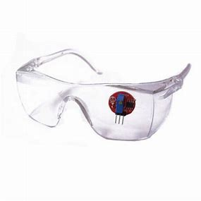
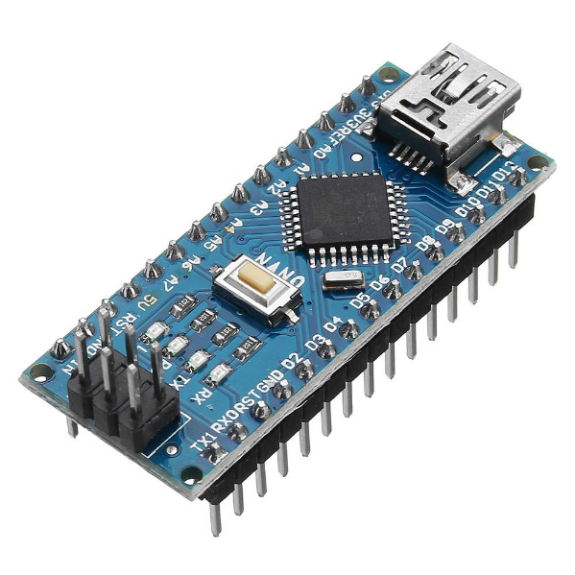
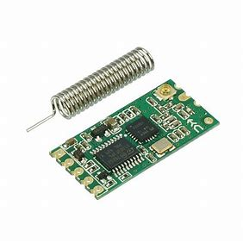
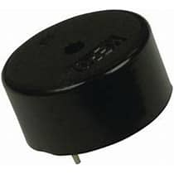
Software and Hardware Requirements:
NODE MCU
IR BASED EYEBLINK SENSOR
BUZZAR
9V BATTERY
12V DC POWER SUPPLY

Slide 8

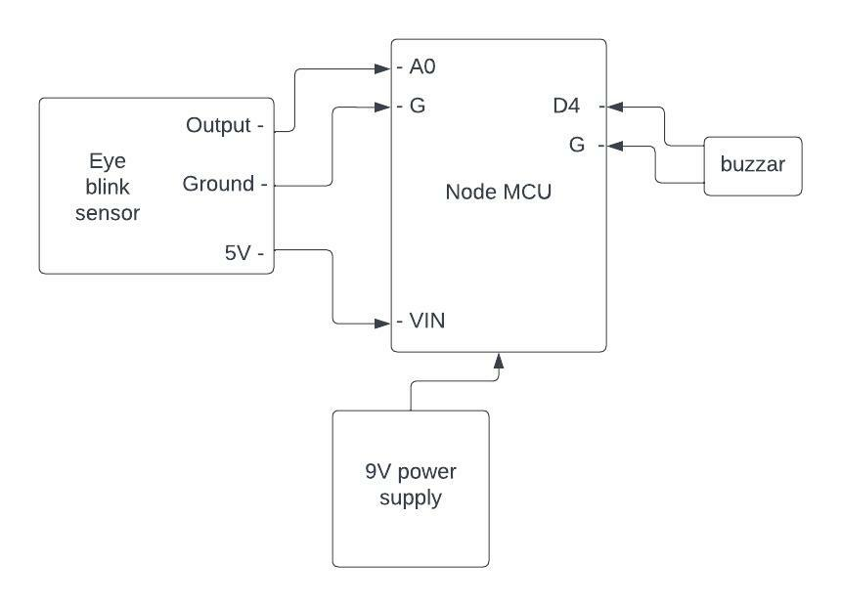
Block Diagram of Proposed System

Slide 9
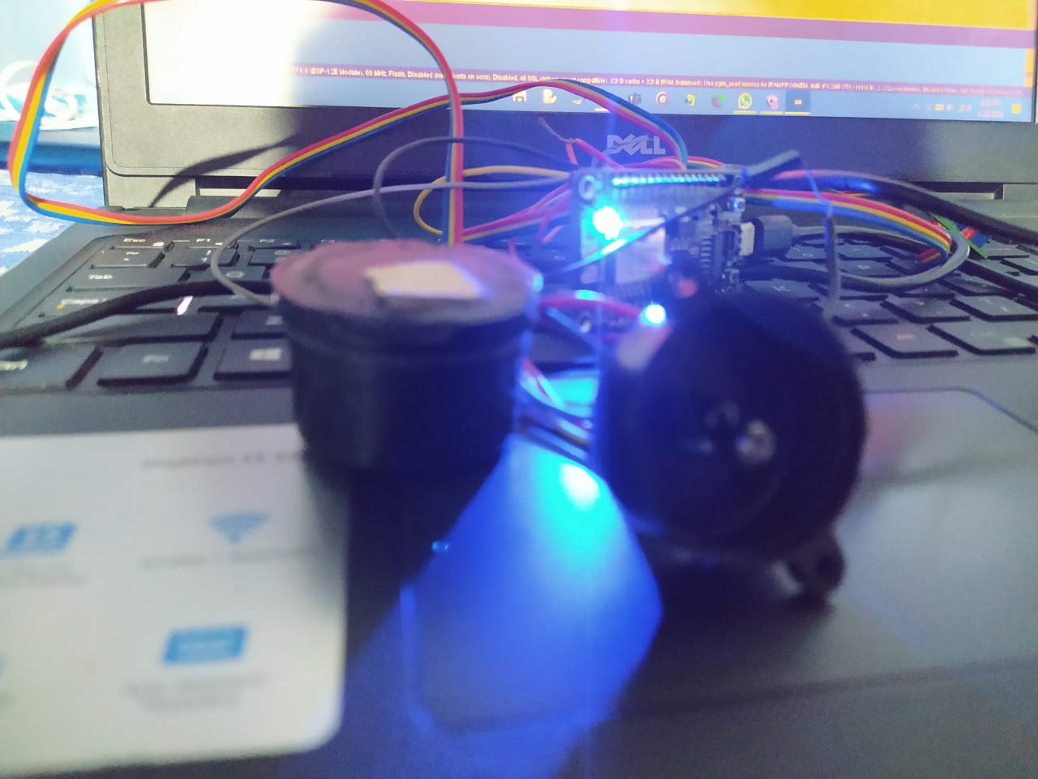
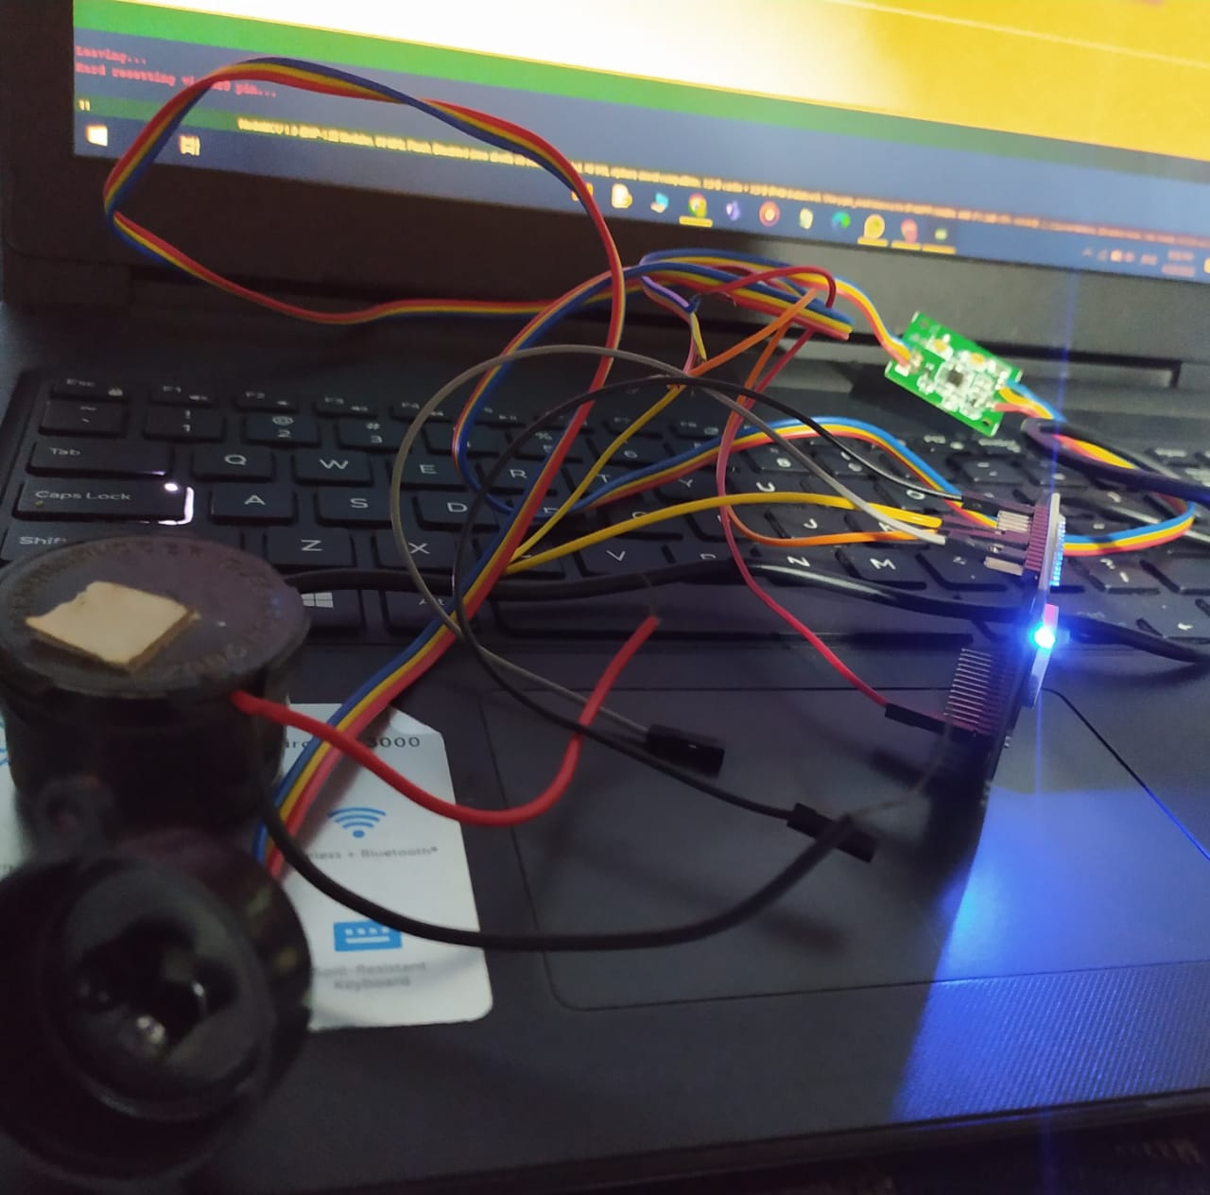
WORKING MODEL:

Slide 10
PROCESS
FIRST CONNECT EYE BLINK SENSORS GROUND TO NODE MCU’S GROUND CONNECTION
CONNECT A0 TO OUTPUT
THEN,VCC PIN SHOULD BE CONNECTED WITH POWER SUPPLY OF 3 VOLT
D2 SHOULD BE CONNECTED WITH BUZZER
IF SENSOR DETECTS THE EYE IS CLOSED UPTO 5 SECONDS THEN THE BUZZER SOUNDS

Slide 11
PROGRAM
int flag=0;
int t1=0;
int t2=0;
void setup() {
Serial.begin(9600);
pinMode(2,OUTPUT); }
void loop() {
int x=analogRead(A0);
if(x<400 && flag==0) {
flag=1; t1=millis();
}
else if(x>400 && flag==1) {
flag=0; t2=millis();
Serial.println(t2-t1);
if((t2-t1)>1000) {
digitalWrite(2,HIGH);
Serial.println("Alert2!!!!!!!!!!!!!!!!!");
delay(2000);
}
else
{
digitalWrite(2,LOW); }
} }

Slide 12
References
https://circuitdigest.com/microcontroller-projects/arduino-based-driver-drowsiness-detection-and-alert-system
https://youtu.be/xbbEEkKYYss
https://www.ijltemas.in/most-viewed-papers/a-survey-on-driver-drowsiness-detection-techniques.com
https://ieeexplore.ieee.org/document/8704263

Slide 13
Weekly Plan
Week 1 | : | Survey of Existing System
Week 2 - 3 | : | Block diagrams of Existing and Proposed Systems
Week 4 | : | Resource Set up
Week 5 - 8 | : | Implementation
Week 9 | : | Result Analysis
Week 10 -12 | : | Report Preparation

Slide 14
Online Certification Courses
Name of the Student | Title of the Course | Organized By | Time Period (from – to) | Duration (Weeks)
S.RAVIPRASATH | ARDUINO VS RASPBERRY PI | GREAT LEARNING
R.AJATHAN | WHAT IS IOT? | GREAT LEARNING
S.SUBHANANDH | AI AND BIG DATA IN IOT | GREAT LEARNING
Team Member 1 | Team Member 2 | Team Member 3

Slide 15
Guide Meeting
Date | Team Members Involved | Discussion Points
 | S.RAVIPRASATH/R.AJATHAN/ S.SUBHAANANDH
 | S.RAVIPRASATH/R.AJATHAN/ S.SUBHAANANDH
 | S.RAVIPRASATH/R.AJATHAN/ S.SUBHAANANDH

